Slide 1
Software Requirement Engineering
Change Management
Muhammad Nasir
m.nasir@iiu.edu.pk

Slide 2
Outline
Why to Manage Change?
Factors Causing Change?
Internal Factors
External Factors
Requirements’ Leakage
Process for Managing Change

Slide 3
Why to Manage Change?
“Software systems are critical assets of any organization, so we must invest in system changes to maintain the value of these assets”. (Ian Sommerville)
“Uncontrollable change is a common source of project chaos/disorder, schedule slips and quality problems.” (Karl E. Wiegers)

Slide 4
Change Management
Karl Wiegers illustrates:
The change should be evaluated properly in advance.
The appropriate individual should make decision about the changes.
Changes should be communicated to all involved participants.
To incorporate requirements changes in a disciplined fashion.

Slide 5
Factors causing change
The factors are categorized as follows:
External Factors
Internal Factors

Slide 6
External Factors
Those change agents over which the project team has no control.
Change in the economy, in government regulations, or in the marketplace and consumer preferences.
Change in the technology.
Changed user minds or their perceptions about what they wanted the system to do.
Changed external environment, which creates new constraints and/or new opportunities (ongoing improvements in computer hardware and software system).
The organizational behavior evolves around the new system, the old ways of doing things are no longer appropriate; the need for new types of information emerge, a new requirements for the system inevitably develop.

Slide 7
Internal Factors
Those change agents over which the project team has control.
Failed to ask the right people the right questions at the right time during the initial requirements gathering effort.
Process of designing expose new requirements
There is no practical process to manage changes, avoiding changes and freezing requirements, eventually pilling-up of changes, causing stress and rework.

Slide 8
Requirements’ Leakage
Weinberg [1995] notes that change can indeed be insidious.
He compared the known requirements of the system at the end of one project
He discovered many requirements were surprisingly "unofficial," or what Weinberg calls "requirements leakage."

Slide 9
Requirements’ Leakage: Un-official sources of requirements
Enhancements mentioned by distributors who had been overheard by programmers at a sales convention
Direct customer requests to programmers
Mistakes that had been made and shipped and had to be supported
Hardware features that didn't get in or didn't work
Knee-jerk change-of-scope reactions to competitors
Functionality inserted by programmers with "careful consideration" of what's good for the customer
Programmers' "Easter Eggs"
Notes:
An Easter Egg is a hidden behavior built into the system for debugging purposes, for "the fun of it," or, occasionally, for worse motives. In our experience, Easter Eggs are extremely dangerous, and programmers must know that inserting them is completely unacceptable and that doing so will subject the offenders to dire consequences.

Slide 10
Requirements’ Leakage
Un-official sources contributed up to half of the total scope of one project!
In other words, half of the total work product of the system was invested in requirements leakage
or requirements that entered the system without visibility to the team members responsible for managing the schedule, budget, and quality criteria.

Slide 11
Requirements’ Leakage: Case 1
A large military simulation system took a long time to execute, so the programmers built into the system a background game of Battleship to amuse themselves during the simulation. Unfortunately, they never took it out, nor did its existence appear on any of the verification and validation activities or reports. When it was discovered, the customer, having lost confidence in the subcontractor, canceled the entire program: a multimillion-dollar loss to the subcontractor and a serious detriment to future business opportunities.

Slide 12
Requirements’ Leakage: Case2
A junior programmer contributing to the development of a shrink-wrapped software tool amused himself by building in derogatory user error messages in early stubs of error-recovery code. One such message was accidentally left in and discovered by a customer in a formal product training session. The software had to be repaired and re-released on an unplanned basis, causing the loss of critical team-weeks to the company.

Slide 13
A Process for Managing Change
Recognize that change is inevitable/expected, and plan for it.
Baseline the requirements.
Establish a single channel to control change.
Use a change control system to capture changes.
Manage change hierarchically.

Slide 14
Step 1: Recognize that Change is Inevitable, and Plan for It
The team should develop an awareness that changing requirements are expected and necessary.
Plan for managing change that should include some allowance for change in the initial baseline.

Slide 15
Step 2: Baseline the Requirements
At the end of the elaboration phase the team should baseline all known requirements for the system.
The base-lining process means collection of itemized requirements in a document.
Once the baseline has been established, new requirements can be more easily identified and managed.
A request for a new requirement can be compared against the existing baseline as whether it will create a conflict with any other requirements

Slide 16
Step 3: Establish a Single Channel to Control Change
It is crucial that every change go through a single channel to determine its impact on the system.
And to make the official decision as to whether the change is going to be made in the system or not.
In a small project, this official channel can be
The manager
The "owner" of the Vision document and other requirements artifacts
Someone who has an overall understanding of the system requirements and design.

Slide 17
Step 3: Establish a Single Channel to Control Change (cont...)
In larger systems or ones that affect a variety of stakeholders, this official channel should consist of a few people (a Change Control Board, or CCB) to decide when a change-request is officially approved.

Slide 18
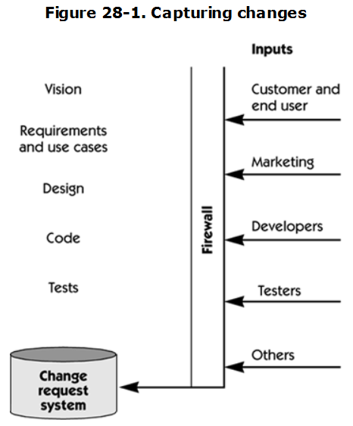
Step 3: Establish a Single Channel to Control Change

Slide 19
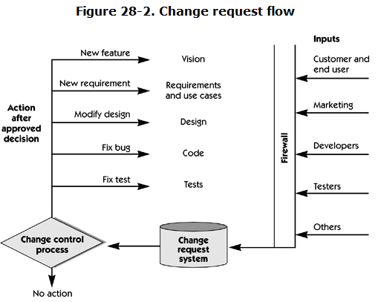
Step 3: Establish a Single Channel to Control Change

Slide 20
Step 4: Use a Change Control System to Capture Changes
During development, there will be a number and variety of other types of potential changes to the system.
The system should be used to capture all inputs and to transmit them to the authority of the change control board (CCB) for resolution.
The CCB should consist of no more than three to five people who represent the key stakeholders for the project: customers, marketing, and program management.

Slide 21
Step 4: Use a Change Control System to Capture Changes (cont...)
The CCB must consider the following factors:
The impact of the change on the cost and functionality of the system.
The impact of the change on customers and other external stakeholders not well represented on the CCB
i.e., other project contractors, component suppliers, and so on.
The potential for the change to destabilize the system.

Slide 22
Step 5: Manage Change Hierarchically
A change to one requirement can have a "ripple effect“.
New feature/requirement has an impact on the cost, schedule, reliability, and risk of the project.
To mitigate this ripple effect, changes to the requirements should be carried out in the top-down hierarchical fashion.

Slide 23
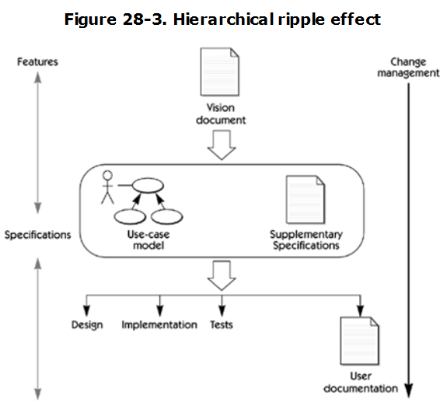
Step 5: Manage Change Hierarchically

Slide 24
Change/Configuration Management Benefits
Change management practices help you to understand and manage these important project development aspects
To determine the amount of rework that may be required to accommodate change.
To determine the effect of a change on your project resource planning (budget, schedule).
To determine the effect of a change on the other elements of the system.
Help to "roll back" a requirement and examine a previous revision of the requirement.
Helpful to remember how and why the requirement was changed.

Slide 25
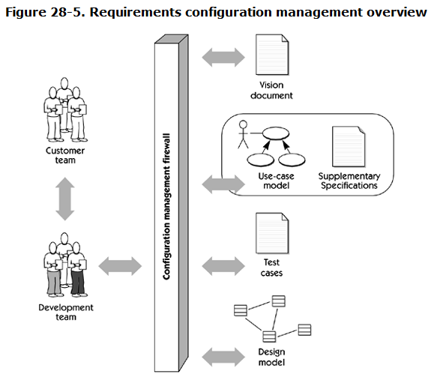
Change/Configuration Management

Slide 26
Three level change history
A change history should exist at three levels within your project.
Finest level: The change history records all changes to each individual requirement within the project.
Middle level: Automatically maintain a similar change history for each project document.
General level: Automatically maintain a similar change history for the entire project.

Slide 27
Conclusion
Finally, building the right system is the matter of managing change.
Change is a way of life; we can plan for change and manage it.
Managing change helps us make sure that the system we built is the right and it continues to be the right system over time.
With a comprehensive change control process in place the team will be well prepared for the challenge of “managing change”.
Notes:
Validation: Are we building the right product? How: By tracing system functionality to requirements
Verification: Are we building the product right? How: By checking system functionality with testing

Slide 28
The End
Thanks for listening
Questions would be appreciated.

